Slide 1
Week 2

Slide 2
Administrative
Scribes and Presentations assigned
Linked from course website later today
Looking for 3 additional scribes – please sign up if willing
Looking for scribes for today
Scribes
Latex PDF or Markdown document
Note down points made during reading and discussion
Clean up notes after class, send to yiru on slack by Friday evening
Posted by the following class

Slide 3
Administrative
Prefer slack over email
Created channels for assignments and reviews
Thanks to the students that used nb.mit

Slide 4
Administrative
No class next week
Assignment 2 out later tonight.

Slide 5
Research and Courses
Intro courses: teaches correct/incorrect “facts”
Research: often times no “correct answer”
No paper (outside of theory) completely solves a problem
They only provide ideas and some evidence
We decide what we believe
This class: get comfortable asking and answering own questions
Notes:
Value in asking questions
Lots of value in proposing answers, and looking for evidence to validate those answers. Some evidence may be in papers (related work), and other evidence requires experiments (aka doing research)

Slide 6
Visualization Grammars

Slide 7
Polaris
Context
Contributions
Comments

Slide 8
Context. 2000s!

Slide 9
Context
2002: Polaris paper published (Chris Stolte, Diane Tang, and Pat Hanrahan)
2003: Tableau Founded (Chris Stolte, Pat Hanrahan, and Christian Chabot)
2013: IPO launched ($250M)
2016: Full year revenue is $826.9M
2018: Worldwide company 80+ offices, 3000+ employees
2019: bought by Salesforce for $16B

Slide 10
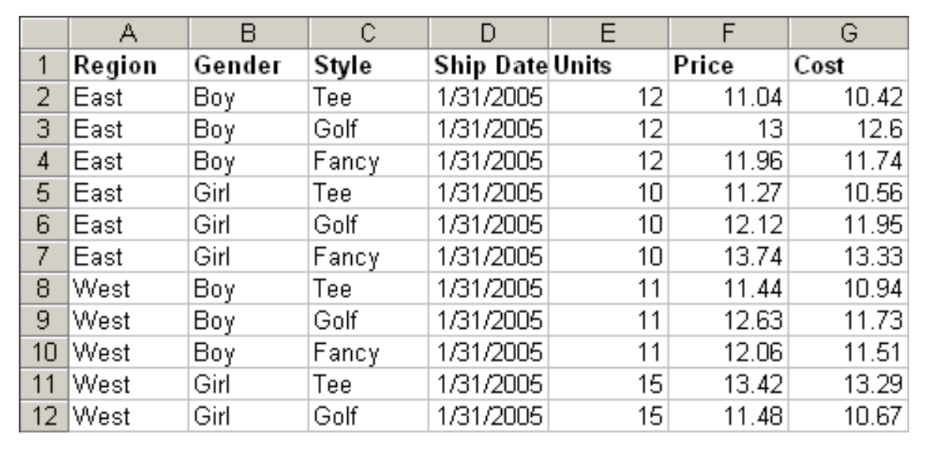
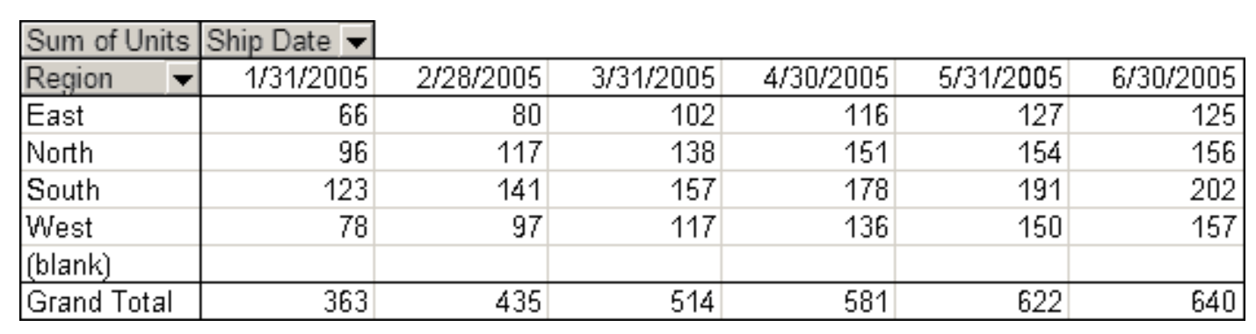
Pivot Tables

Slide 11
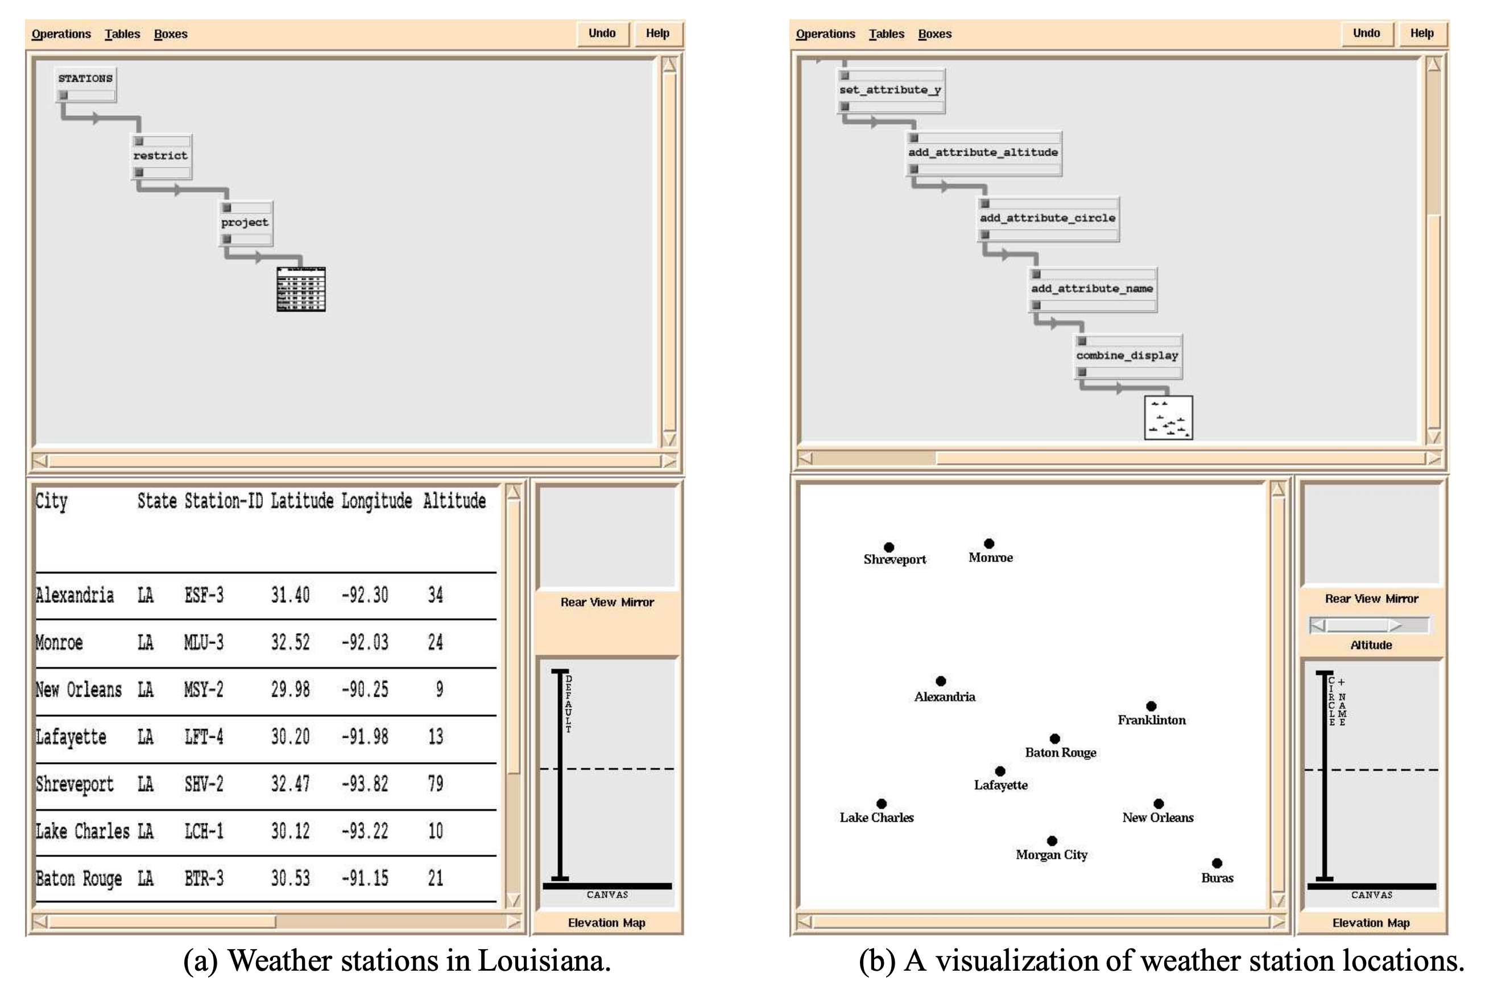

Slide 12
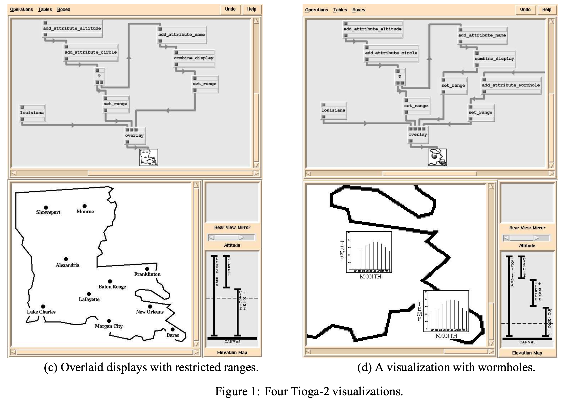
Notes:
Designed around specific interactions (drill down, wormholes aka links, coordinated scrolling, magnifying glass)
https://theory.stanford.edu/~aiken/publications/papers/icde96.pdf

Slide 13
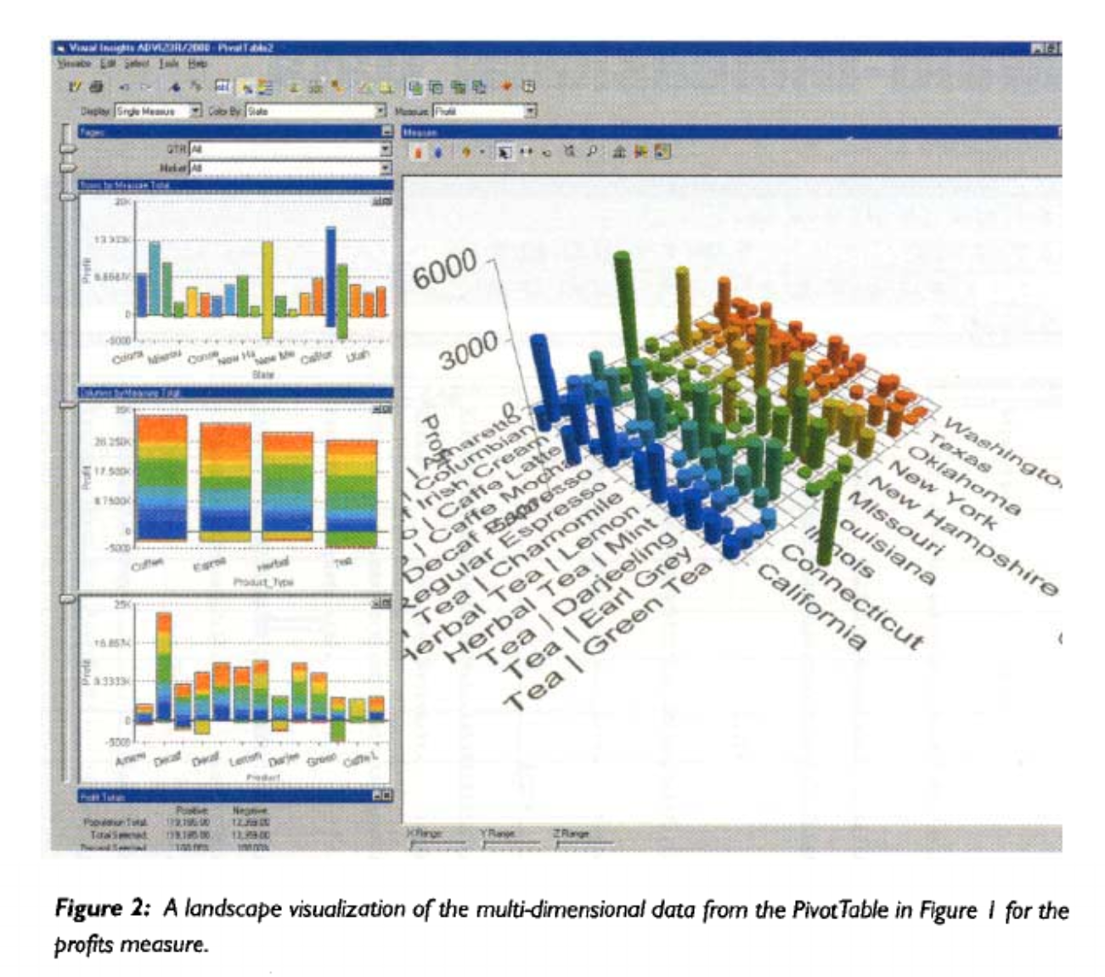
Visual Insights
Notes:
Visual Insights system: https://dl.acm.org/doi/pdf/10.1145/563788.604454
Same data as Polaris examples

Slide 14
Prior Work
Focused on specific types of visualizations,
how to write SQL-esque statements
Prescriptive about presentation and interactions
Menu-based vs direct manipulation
Have to implement data processing and presentation together
Notes:
Today, app is decoupled from data processing (queries)

Slide 15
Contributions
Allow analysts to rapidly specify and change visualizations to explore large multidimensional databases

Slide 16
Contributions
Key observation: layout of plots is based on data
Provide a language for specifying layout
Doesn’t prescribe presentation - visual grammar for plotting
Specification: Layout + visual encodings
Intuitive interface based on spec + useful features
Amplifies user interactions for visually comparing aggregate trends

Slide 17
Layout via Table Algebra
Model of the world:
Grid of charts. Same visualization, different data
Hard part: specifying the grid’s x and y (and z) axes
What is an algebra?
Set + operations closed over the set
e.g., (integers, +)
Why an algebra?
Easier to map interactions to algebra operations
Understand completeness of interface interactions

Slide 18
Data Model
Data Types
Ordinal: discrete attributes (countries, animals)
Quantitative: continuous attributes (costs, time)
Attribute Types
Dimensions: used to group
Measures: used to compute

Slide 19
Operators
Operands: ordered list of values/attributes
Region + Gender = {East, West, .., Boy, Girl}
Region + Units = {East, West, North, South, Units}
Units + Price = {Units, Price}

Slide 20
Operators
Operands: ordered list of tuples
Region * Gender = {(East, Boy), (West, Boy), …}
Region * Units = {(East, Units), (West, Units)}

Slide 21
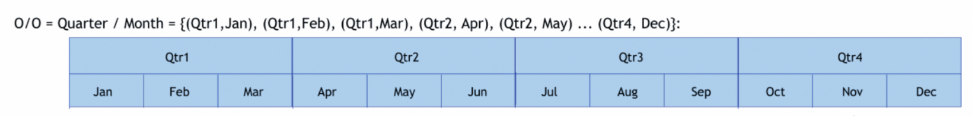
Operators
Operands: ordered list of tuples
Region / Gender = {(East, Boy), (East, Girl), (West, Boy) …}
Only keep combinations that exist in the database

Slide 22
Visualizations
Each layer specifies
Mark type
Mappings from data attributes to mark visual attributes
Defaults based on data types
Ordinal-Ordinal
Ordinal-Quantitative
Quant-Quant
Follow up on Auto Presentation: Mackinlay, J. D., et al. Show me: Automatic presentation for visual ￼analysis.

Slide 23
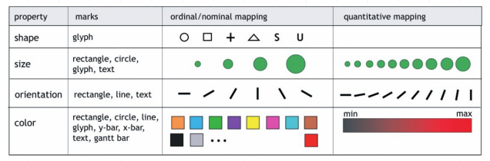
Based on Perceptual Properties

Slide 24
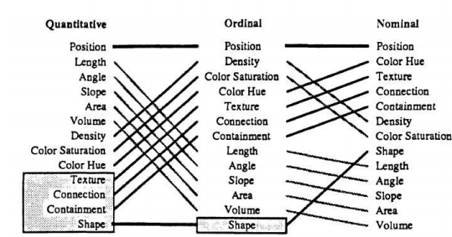
Based on Perceptual Properties

Slide 25
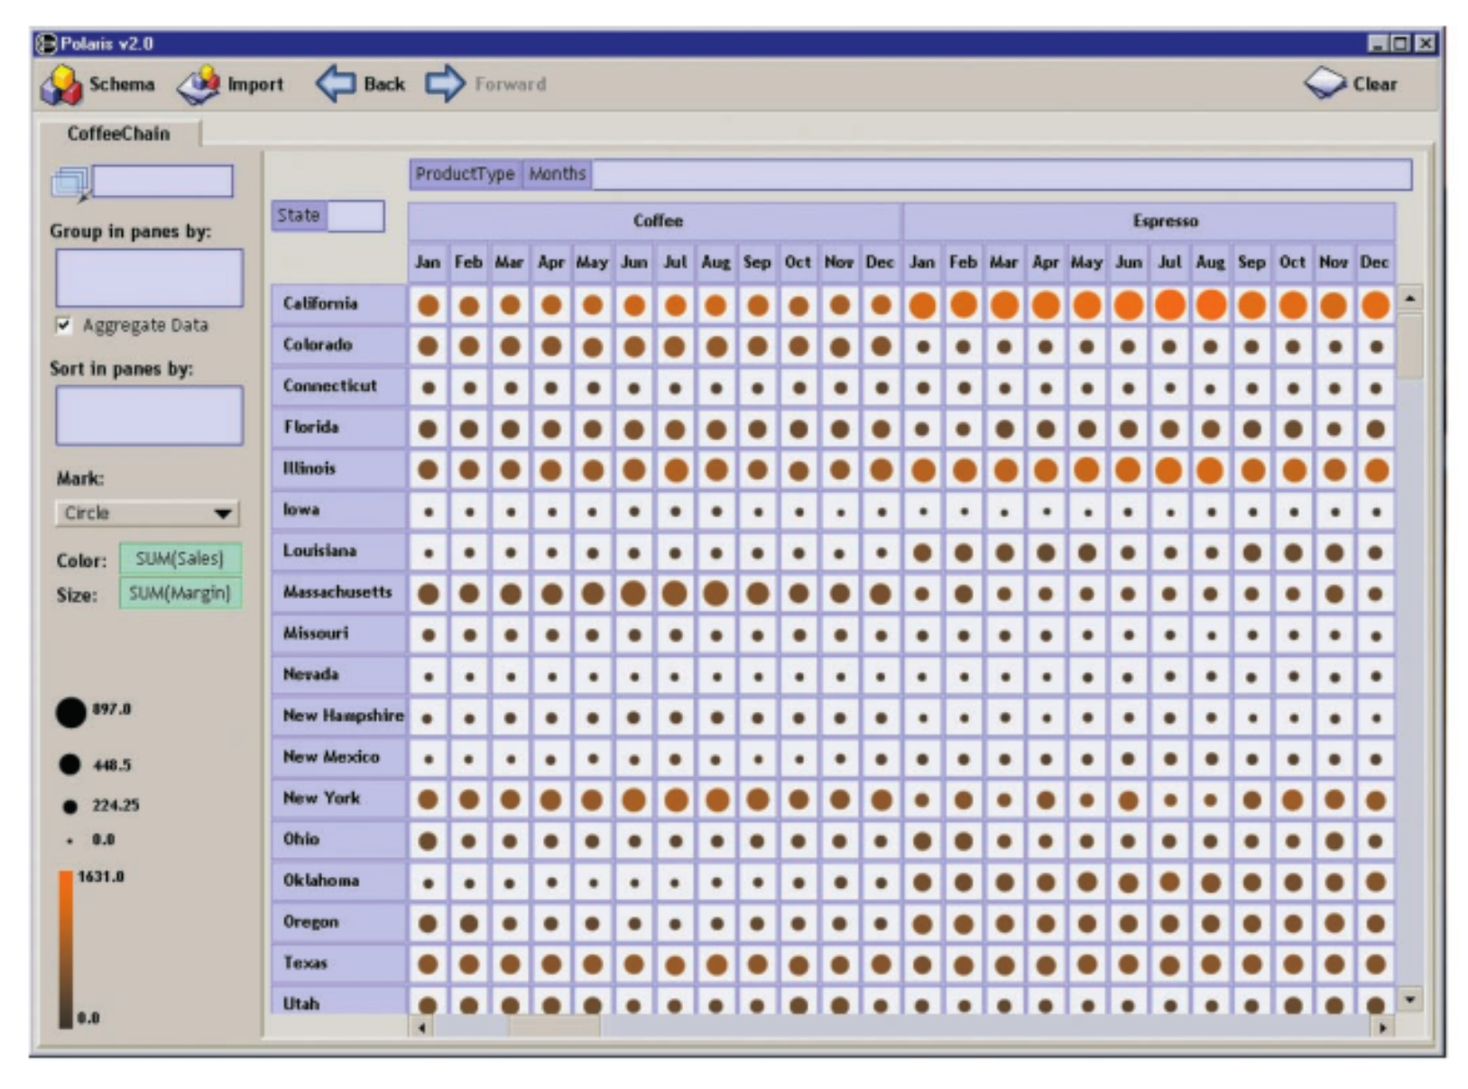
Example 1
Cols: Product * Months
Rows: State
Layer 1
Mark: circle
Color: Sum(sales)
Size: Sum(margin)

Slide 26
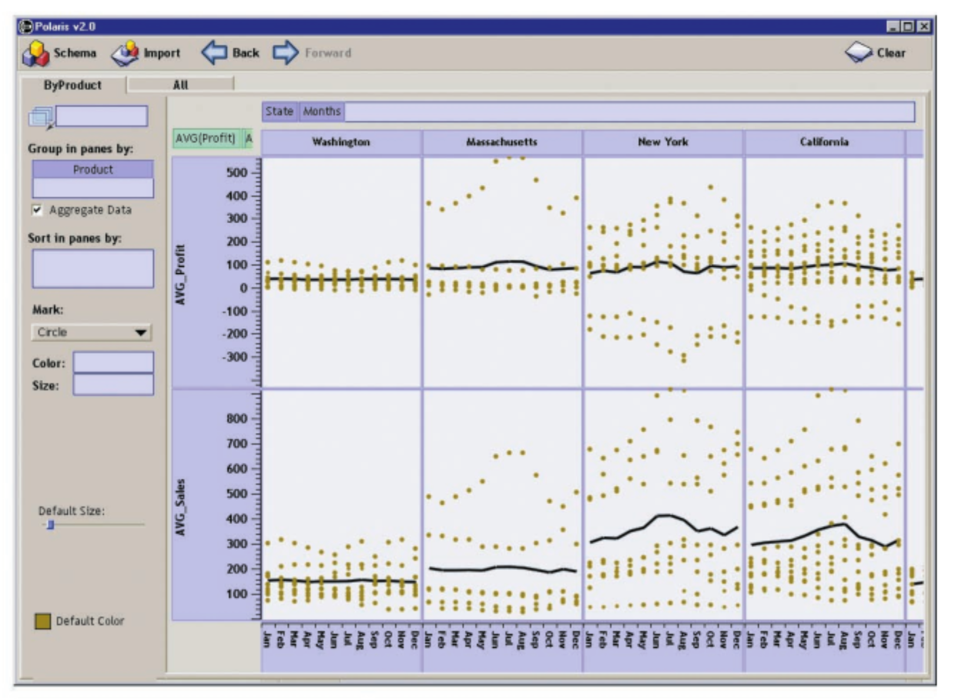
Example 2
Cols: State * Months
Row: Avg(Sales)+Avg(Profit)
Layer 1:
mark: circle
group by: product
y pos: metric
x pos: month
Layer 2:
mark: line
ypos: metric
xpos: month

Slide 27
Menu-based operations
Create new fields
Aggregation function
Discretize a continuous field
Custom groups
”Other” for quantitative fields
Sort/Filter

Slide 28
Running Queries
Apply per-record filters
Select * where [filters]
Figure out list of plots, find rows for each plot
[rows/cols/layers] = select distinct …
Select * where [row_{i}] and [col_{j}] and [layer_{k}]
Run group, sort, aggregation for each plot
SELECT aggs()
GROUP BY {groups} HAVING [filters] ORDER BY …
Render

Slide 29
Discussion

Slide 30
The paper itself
What did you think?
Writing
Technical Depth
Experiments
Evaluation
Value of Contribution

Slide 31
What could the paper have improved?
Some experiments or evaluation of approach
Some notion of completeness or coverage
Still – none of that stopped them from publishing or even better, starting a publicly traded company!
https://www.youtube.com/watch?v=x85KcP5y9HE

Slide 32
Improvements/Future Work
What ways can we improve the system from a data processing standpoint?
Redesign the backend database to optimize for queries of the form described
Use user traces to speculate, optimize, prefetch

Slide 33
Vega Lite

Slide 34
Vega Lite
Paper is not great at clarifying details/what’s going on
Had to read documentation:
https://vega.github.io/vega-lite/docs/

Slide 35
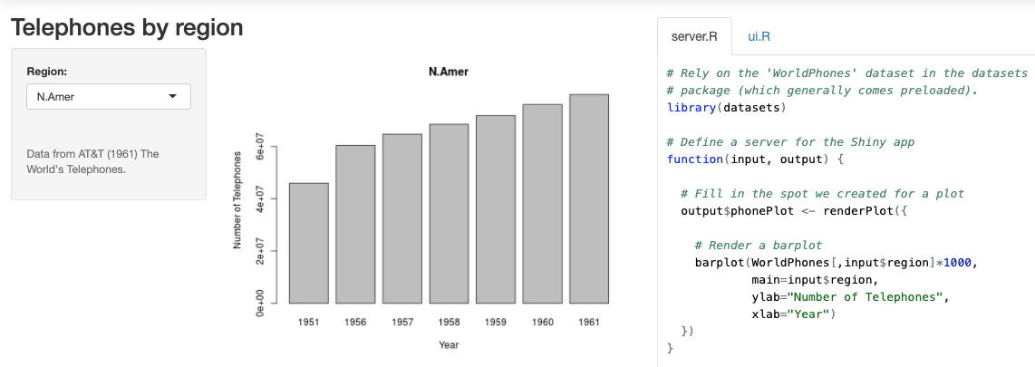
Prior Work
High level languages have limited interaction support
Predefined interactions
https://chart-studio.plot.ly/create/?fid=chelsea_lyn:8648#/
R’s Shiny has parameterized widgets
Notes:
See Proton

Slide 36
Prior Work
High level languages have limited interaction support
Predefined interactions
https://chart-studio.plot.ly/create/?fid=chelsea_lyn:8648#/
R’s Shiny has parameterized widgets
Otherwise, drop to low level
Deal with raw events and callbacks – error prone
Vega is too low level
Notes:
See Proton

Slide 37
Stated Goals
High level, suitable for visual exploration
Extend Vega-lite to support multi-views and interactions
Interaction grammar centered around selections
Selections specify what data elements
Transforms specify how to manipulate selections
Compiler from vega-lite to Vega spec
Illustrated through examples to show expressivity
Notes:
Starting from ggplot, what is needed to define interactions?
What is the expressiveness?
What is the ease of use?
What makes a grammar good? If it composes and minimizes special cases and necessary defaults
Is the grammar necessary? Is it sufficient?

Slide 38
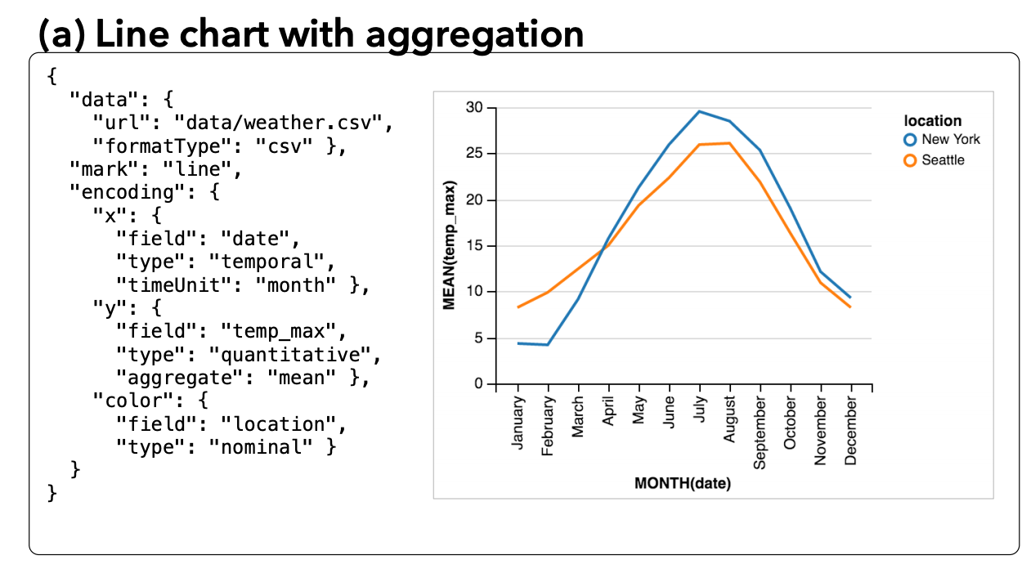
Multi-view: View Algebra
Operands: Unit specification (single plot)
Unit(data | xforms, mark, encodings)
Encoding
Channel
Field & data-type
Value
Functions
Scale
guide
Notes:
Compare and contrast view algebra with tableau’s algebra

Slide 39
Multi-view: View Algebra
Operators for: layers, horizontal/vertical concat, facets, repetition.
layer([units…], resolve)
h/vconcat([views…], resolve)
facet(row/col, data, field ,view, scale, axis, resolve)
repeat(row/col, values, scale, axis, resolve)
Resolve: scales, axes, legend are independent or shared
Notes:
Resolve is like ggplot’s free=x,y,both for facets
Scale, axis args no idea – not in docs
What does this algebra help with? Auto sizing the ranges of subplots’ scales

Slide 40
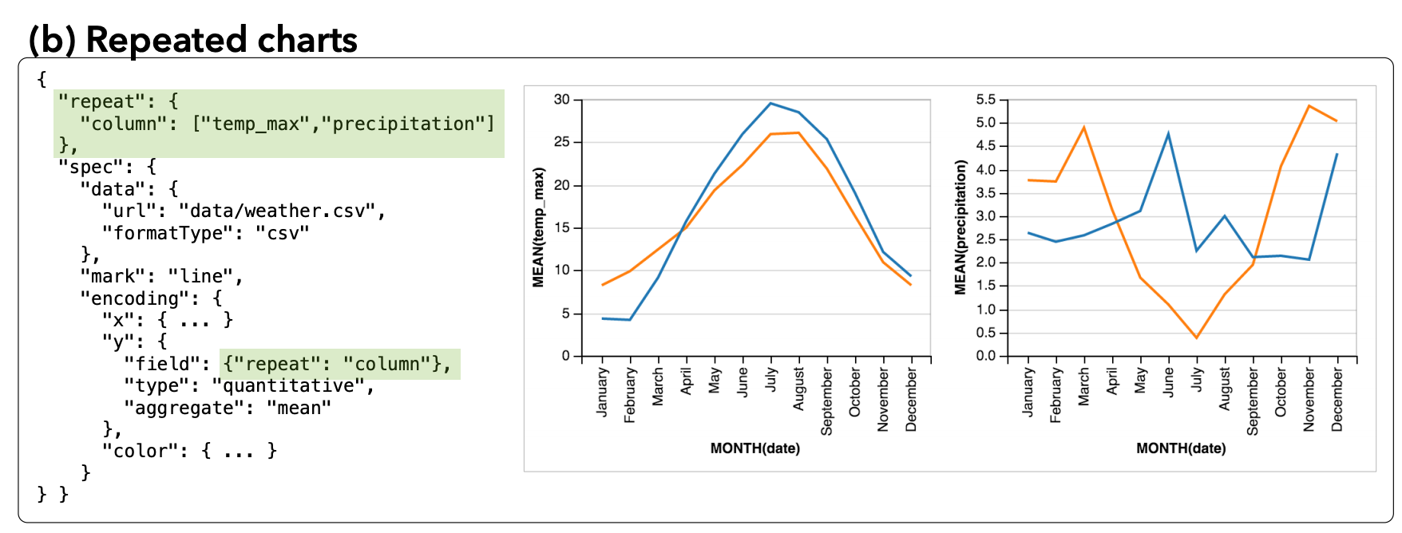

Slide 41
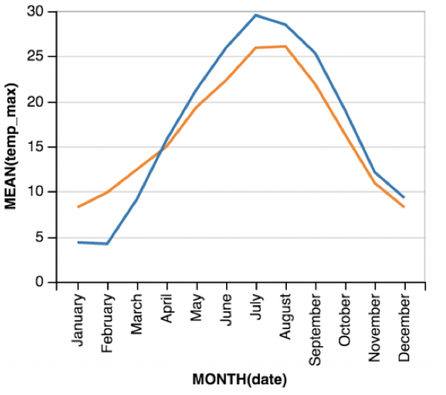
Interaction Grammar
Defines a new data source or variable
selection = (name, type, predicate, domain|range,
event, init, transforms, resolve)
Data space
Pixel/visual space
table
Notes:
Not totally clear what the data model is

Slide 42
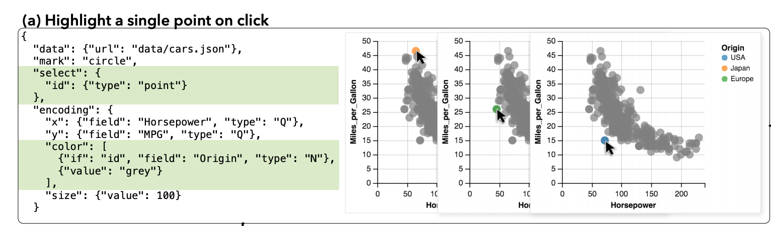
Selection Types
point copy selected record. Same schema as record
list id IN (…list…). Schema same as records (?)
interval range predicate. (x: [min, max], y: [min, max], …)

Slide 43
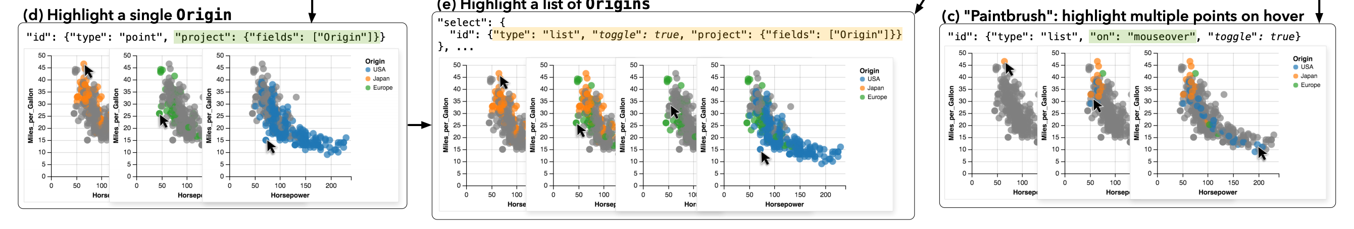
Selection Types
Notes:
Project only keeps Origin, which turns it into a predicate over Origin instead of a predicate over tuple IDs (for some reason).

Slide 44
Transforms
Project fields from a selection’s schema
Toggle updates list selections based on event
Translate the selection in the visual space
Zoom to scale the selection in visual space
Claims commutativity. But translate and zoom not commutative

Slide 45
What can selections be used for?
Part of if-else conditions in encoding channels
Used as a dataset – input to a view
Used as predicate to apply to different dataset
Used in any schema-compatible way
Range or domain of a scale
selection

Slide 46
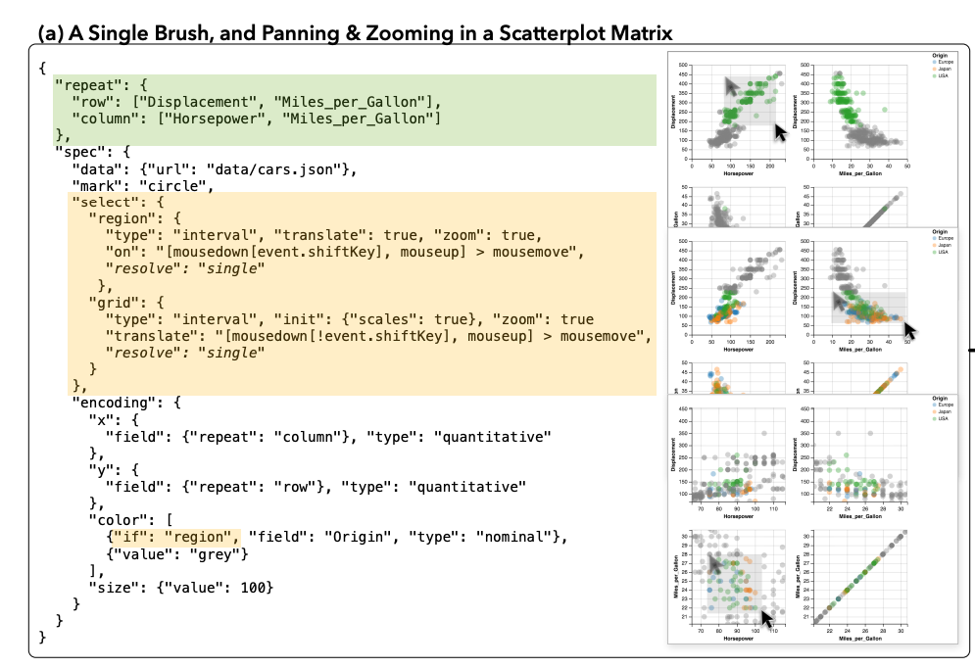
Multi-view selections (facets/repeat)
Selections in multiple views
Single,
independent,
union,
intersect

Slide 47
Tricky parts: conflicting event streams

Slide 48
Discussion

Slide 49
The paper itself
What did you think?
Writing
Technical Depth
Experiments
Evaluation
Value of Contribution

Slide 50
What could the paper have improved?
Clear definition of the algebra and its properties
Some notion of completeness or coverage
Are example-based evaluations the only method for papers about a new language/grammar?

Slide 51
More abstract
What makes a grammar good?
What is an interaction?

